Slide 1
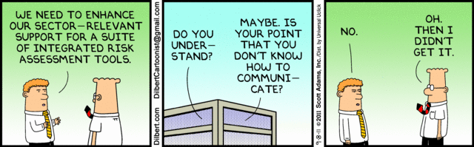

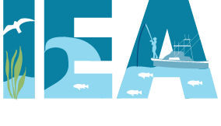
Risk assessments
Elliott Hazen (SWFSC)
Jameal Samhouri (NWFSC)

Slide 2
fishing practices are diverse on the west coast
troll
long line
bottom trawl
midwater trawl
pots
shrimp trawl
albacore
sablefish
whiting
crab
shrimp
chinook
lingcod
Ecology
mobile —> sedentary
pelagic —> benthic
vertebrate — > invertebrate
halibut
Gear
Mobile —> Fixed
Bottom —> Midwater
Selective —> Unselective
rockfish
Management
ITQs
TACs
Seasonal
Notes:
System is diverse, many gears, species targeted and types of management. Have…

Slide 3
NWFSC
Vessels that bring in $ from a greater variety of fisheries have lower financial risk

Slide 4
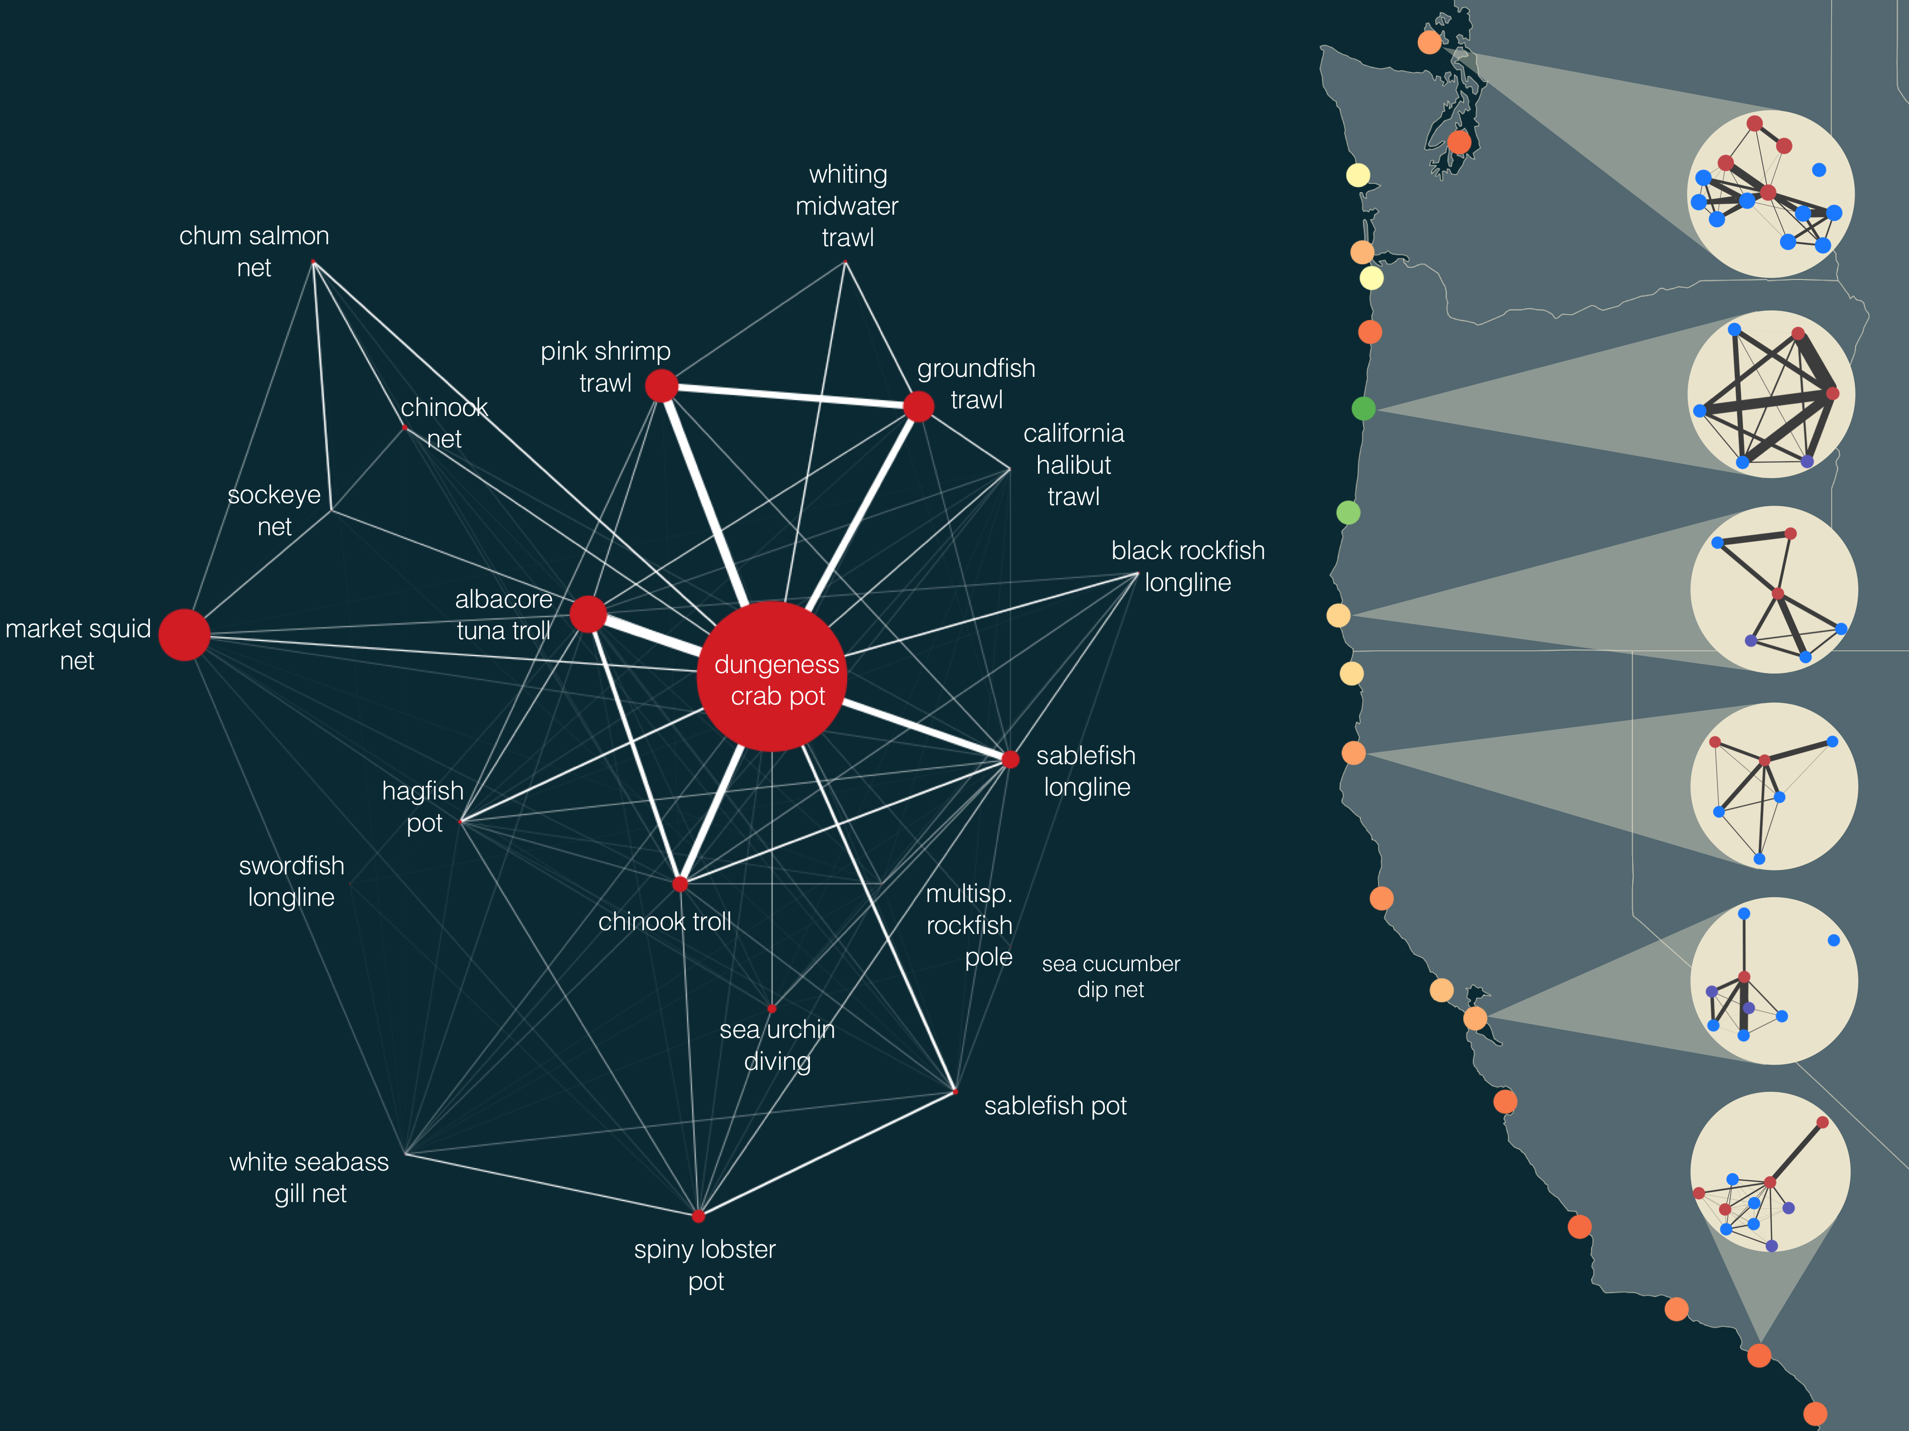
Fishing vessels are embedded within participation networks
NWFSC
The adaptive capacity of these networks varies from community to community
Pacific whiting
Notes:
Fig. 1. Human connectivity of commercial fisheries in the California Current Ecosystem. Fisheries in the California Current are strongly connected by human participation. Some fisheries, notably the Dungeness crab-pot fishery, dominate the coast-wide network. The human connections among fisheries also frequently connect ecologically distant species, i.e. Dungeness crab and albacore tuna or benthic groundfish and pink shrimp. Examining networks generated for port groups on the right, we find that these networks vary in the number of fisheries (nodes) and strength of interconnections. These differences in structure may correspond to differences in community resilience. We color ports using one potential metric of network resilience to highlight this heterogeneity (see supplementary materials for additional metrics). On the right port groups are colored by their adaptive capacity and show port-level participation networks with nodes colored by management jurisdiction (federally managed fisheries are blue, state managed are red, fisheries where both state and federal have a role in management, i.e. nearshore rockfish, are purple). For visual clarity we only include fisheries that had at least 3 vessels participating, and accounted for, on average, 25% of a vessel’s annual income (Materials and methods are available as supplementary materials at the Science website).

Slide 5
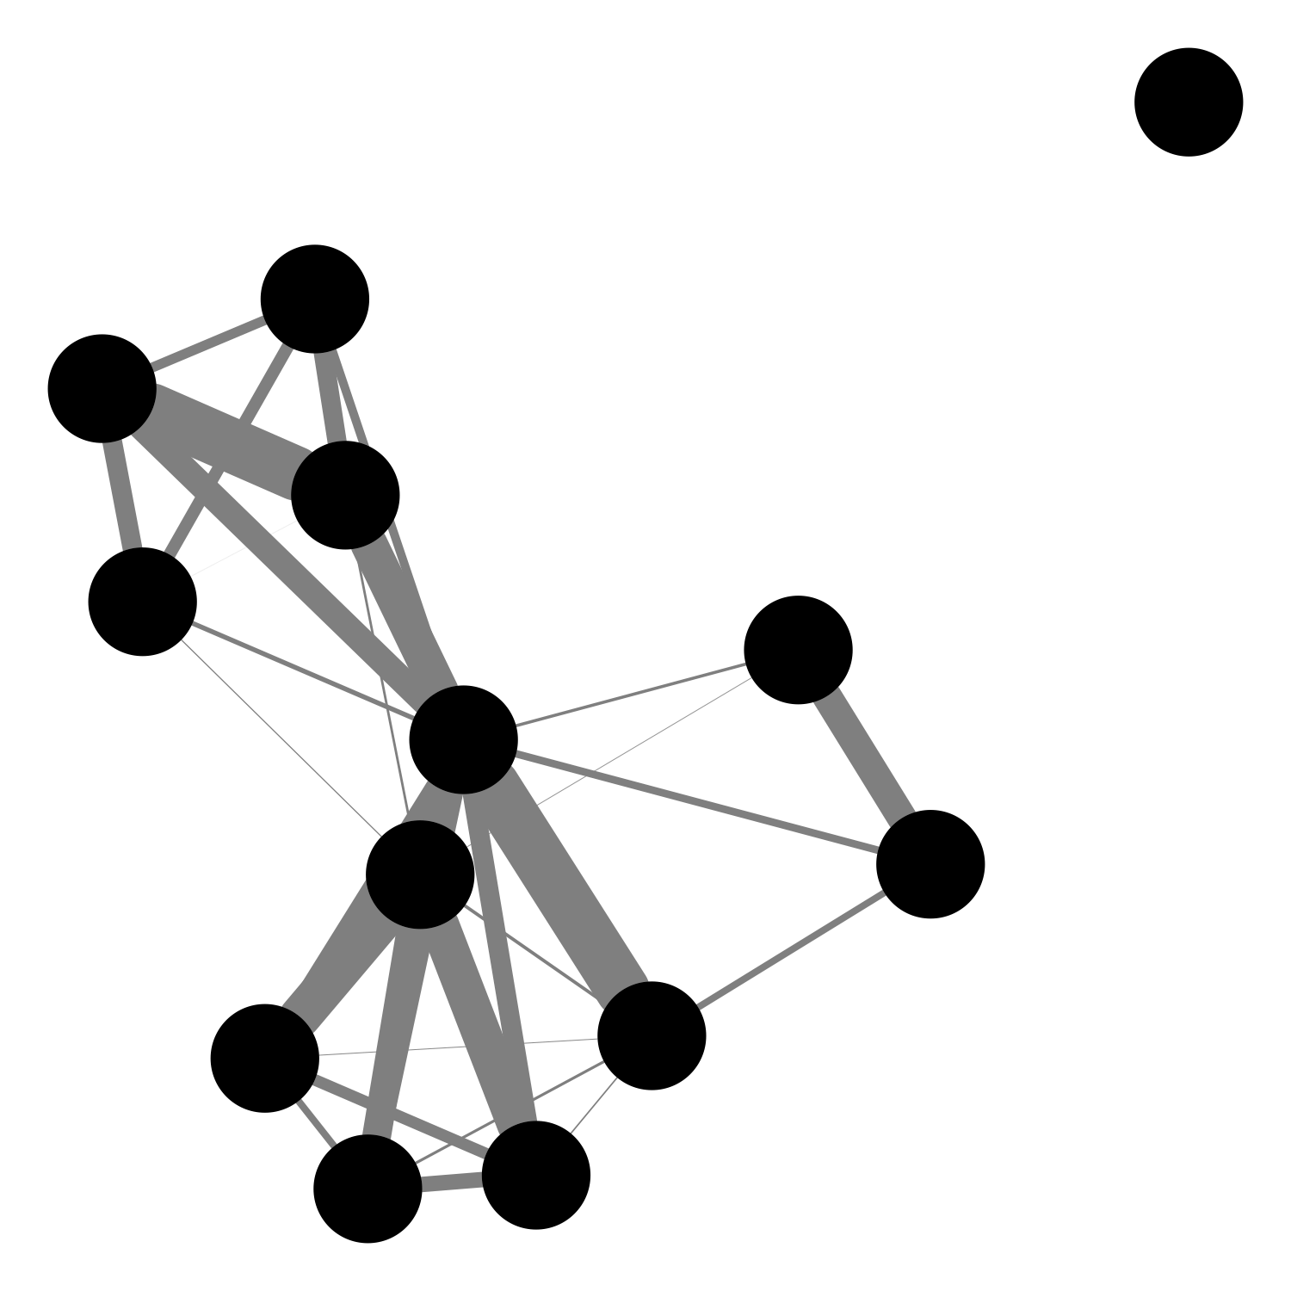
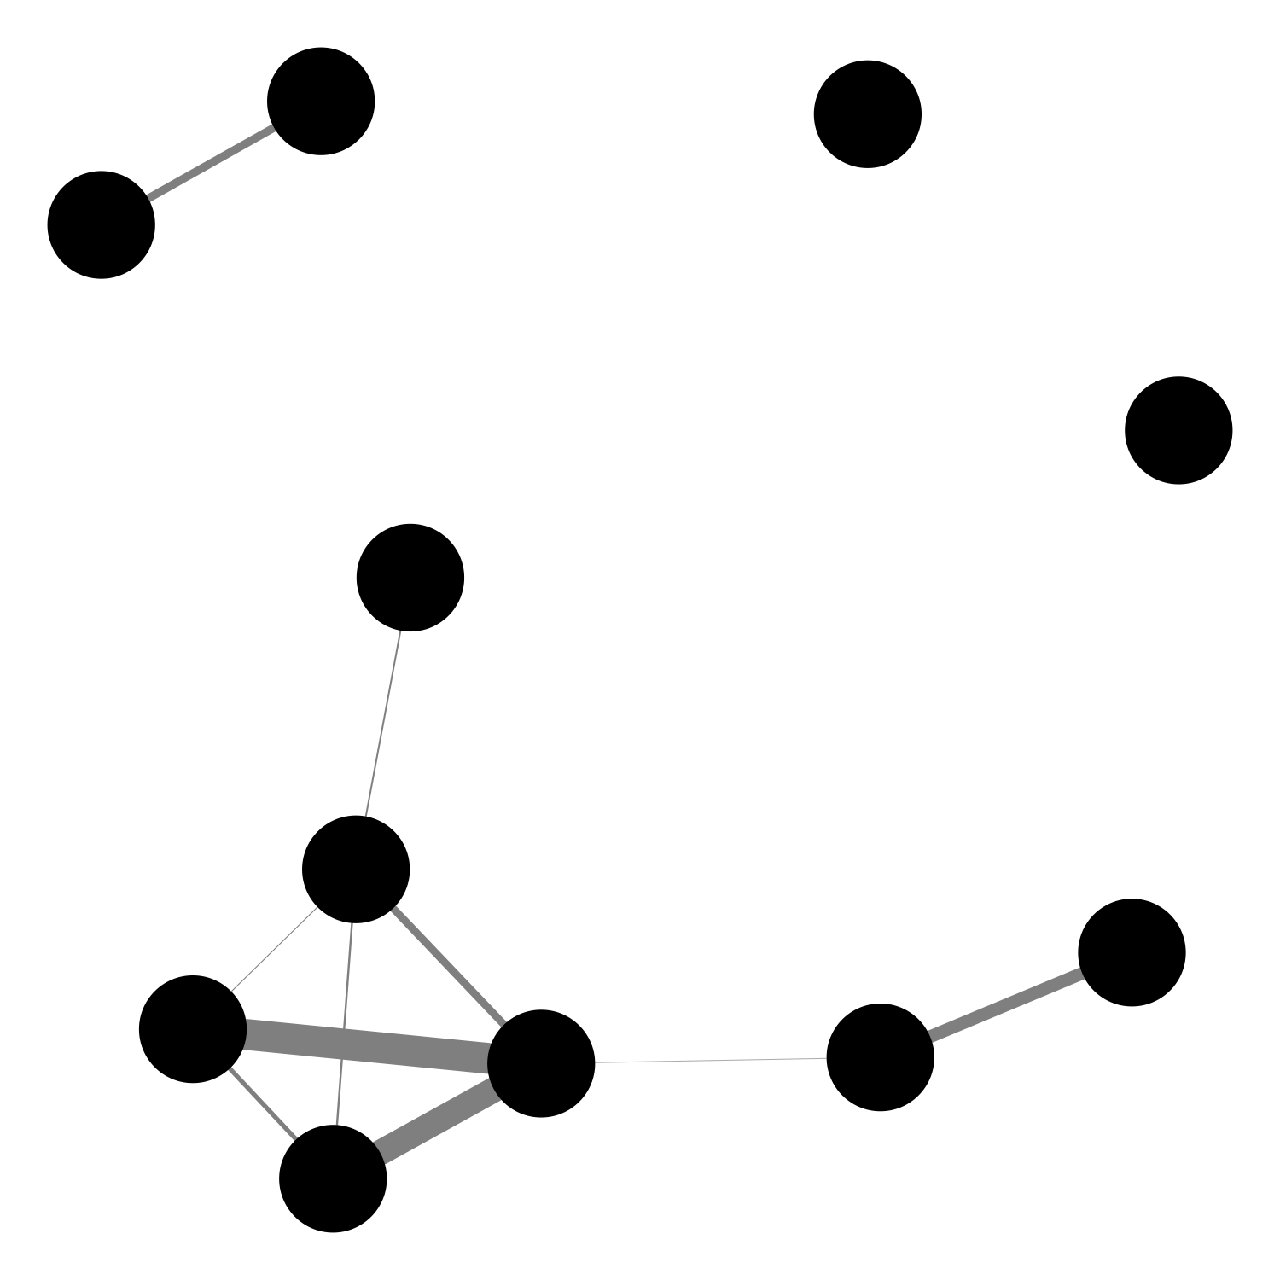
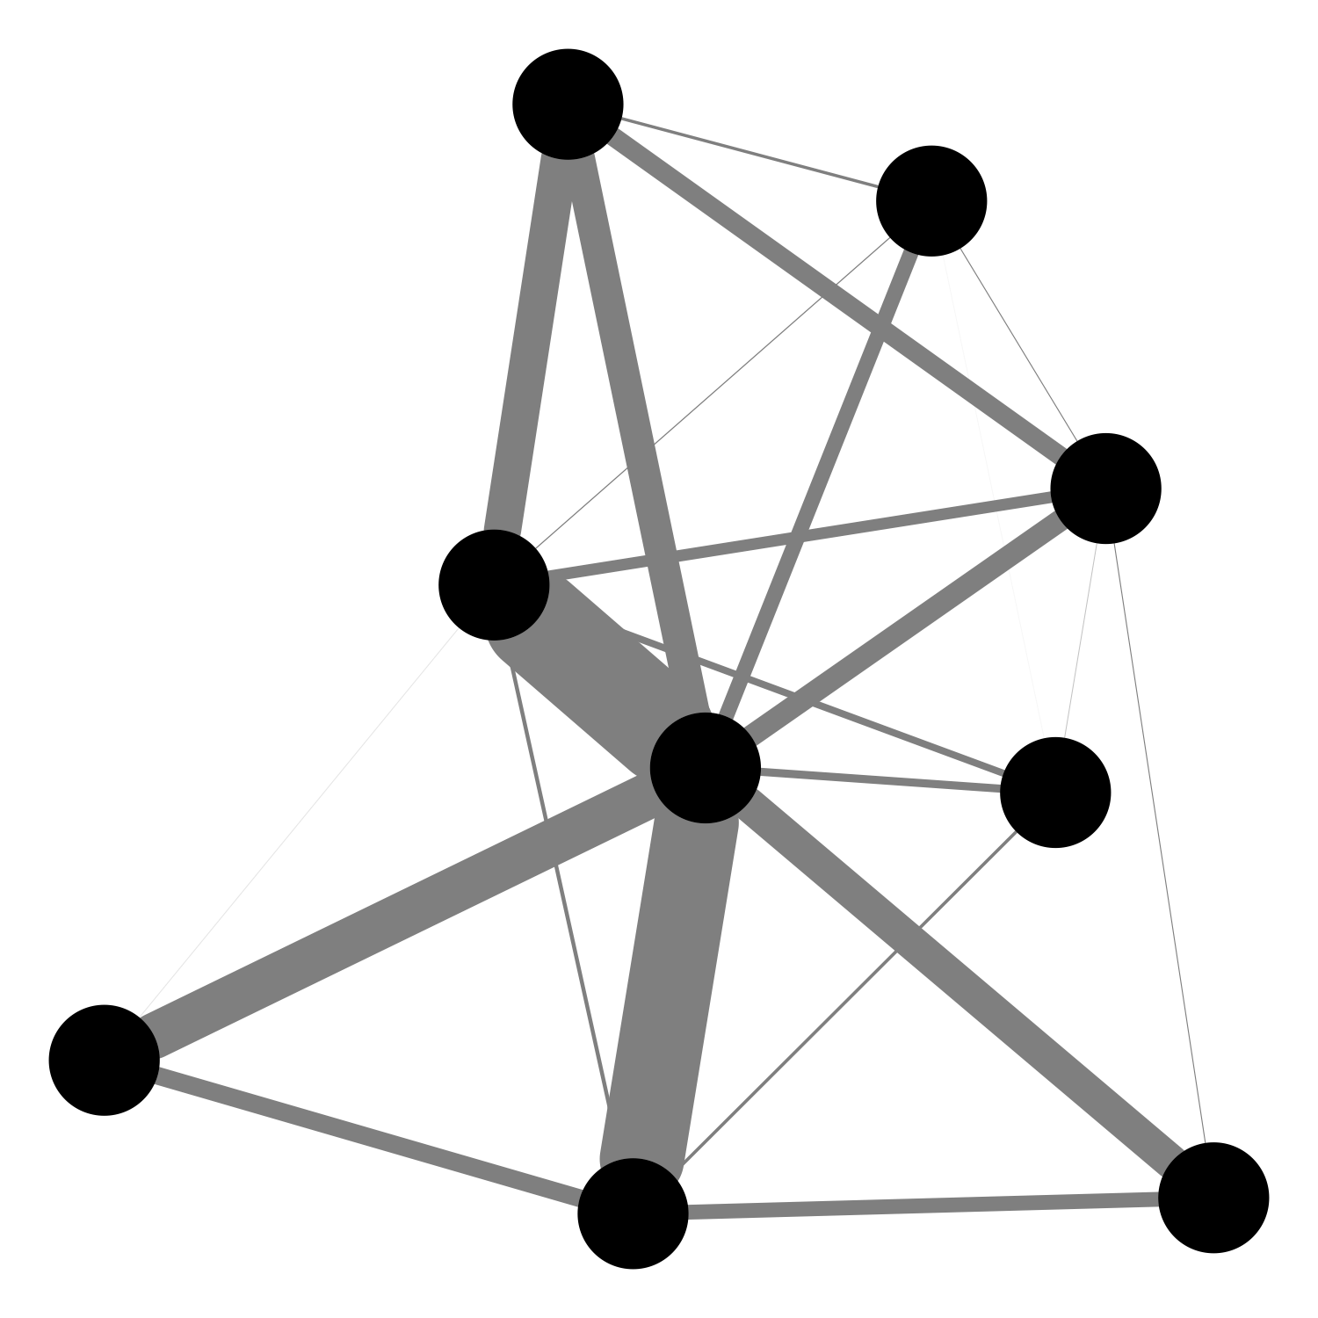
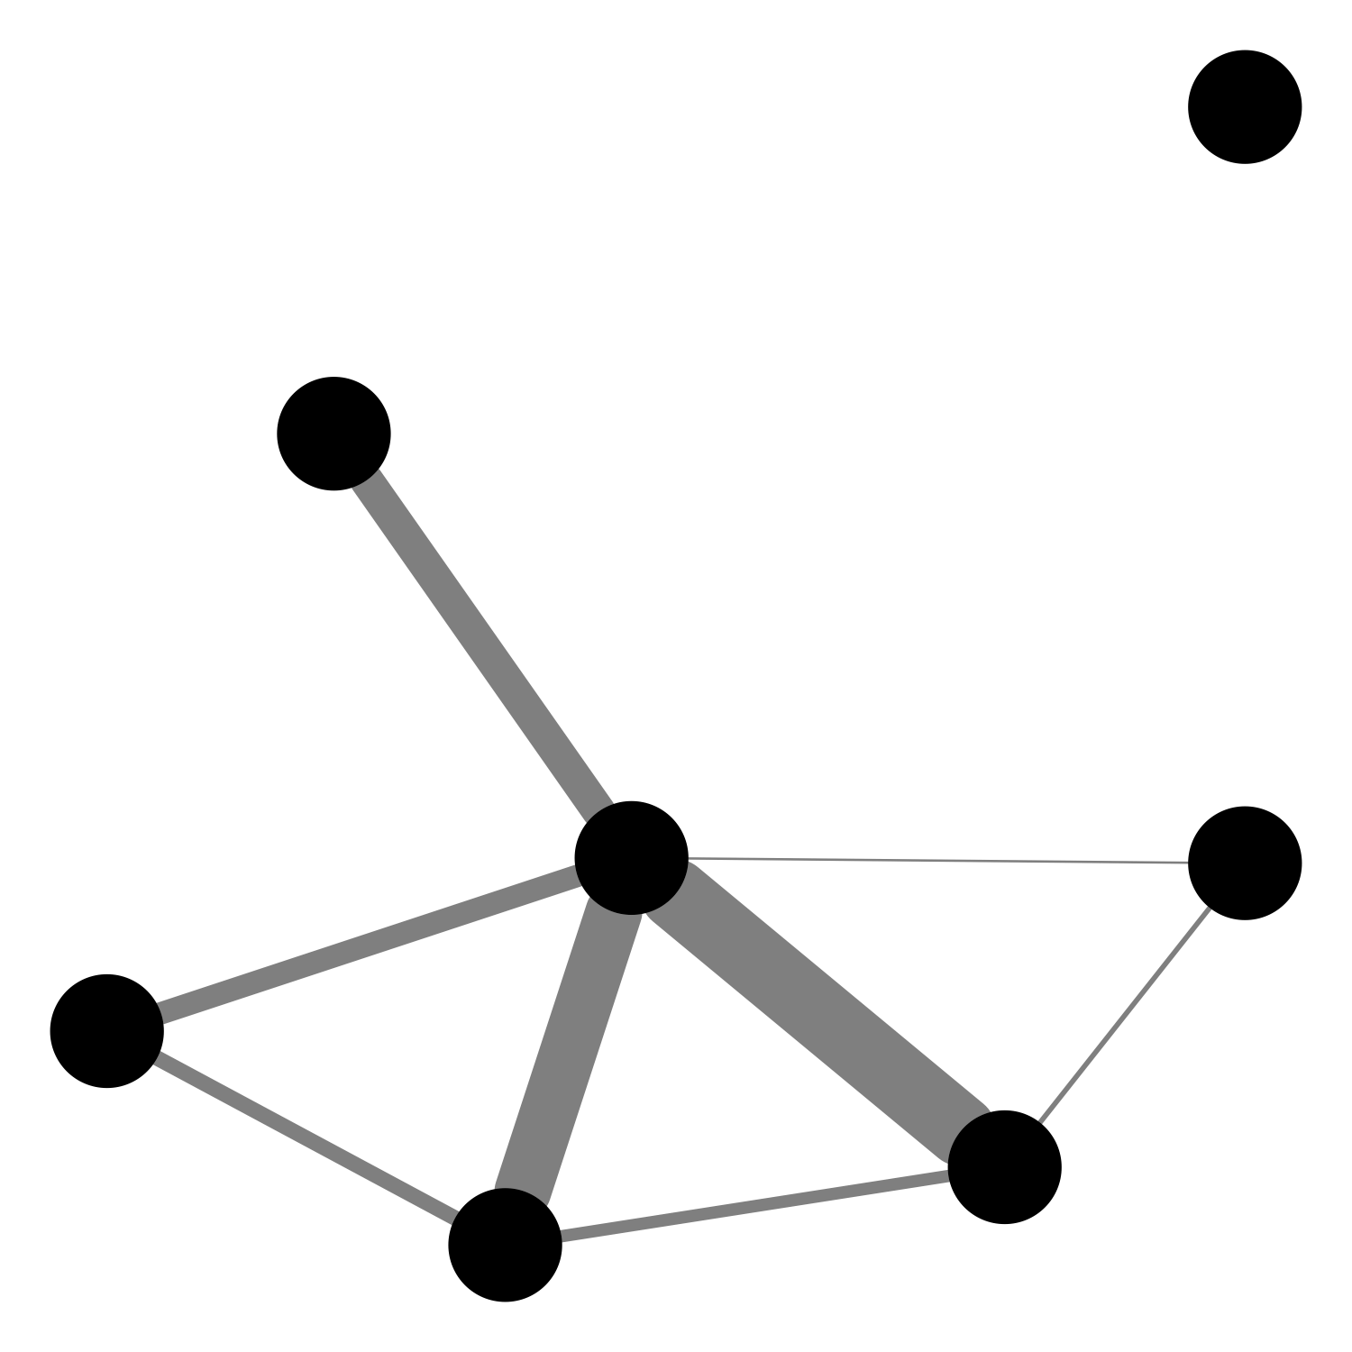
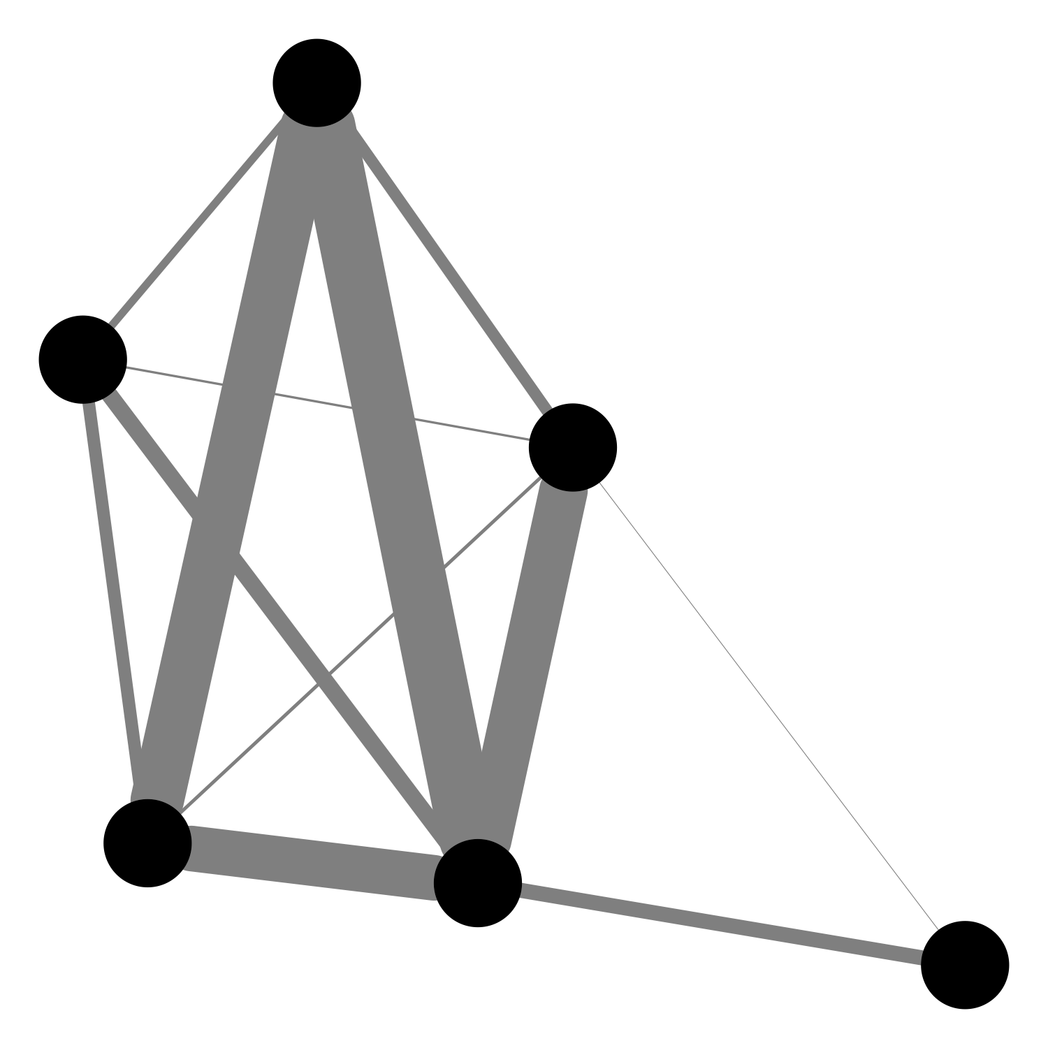
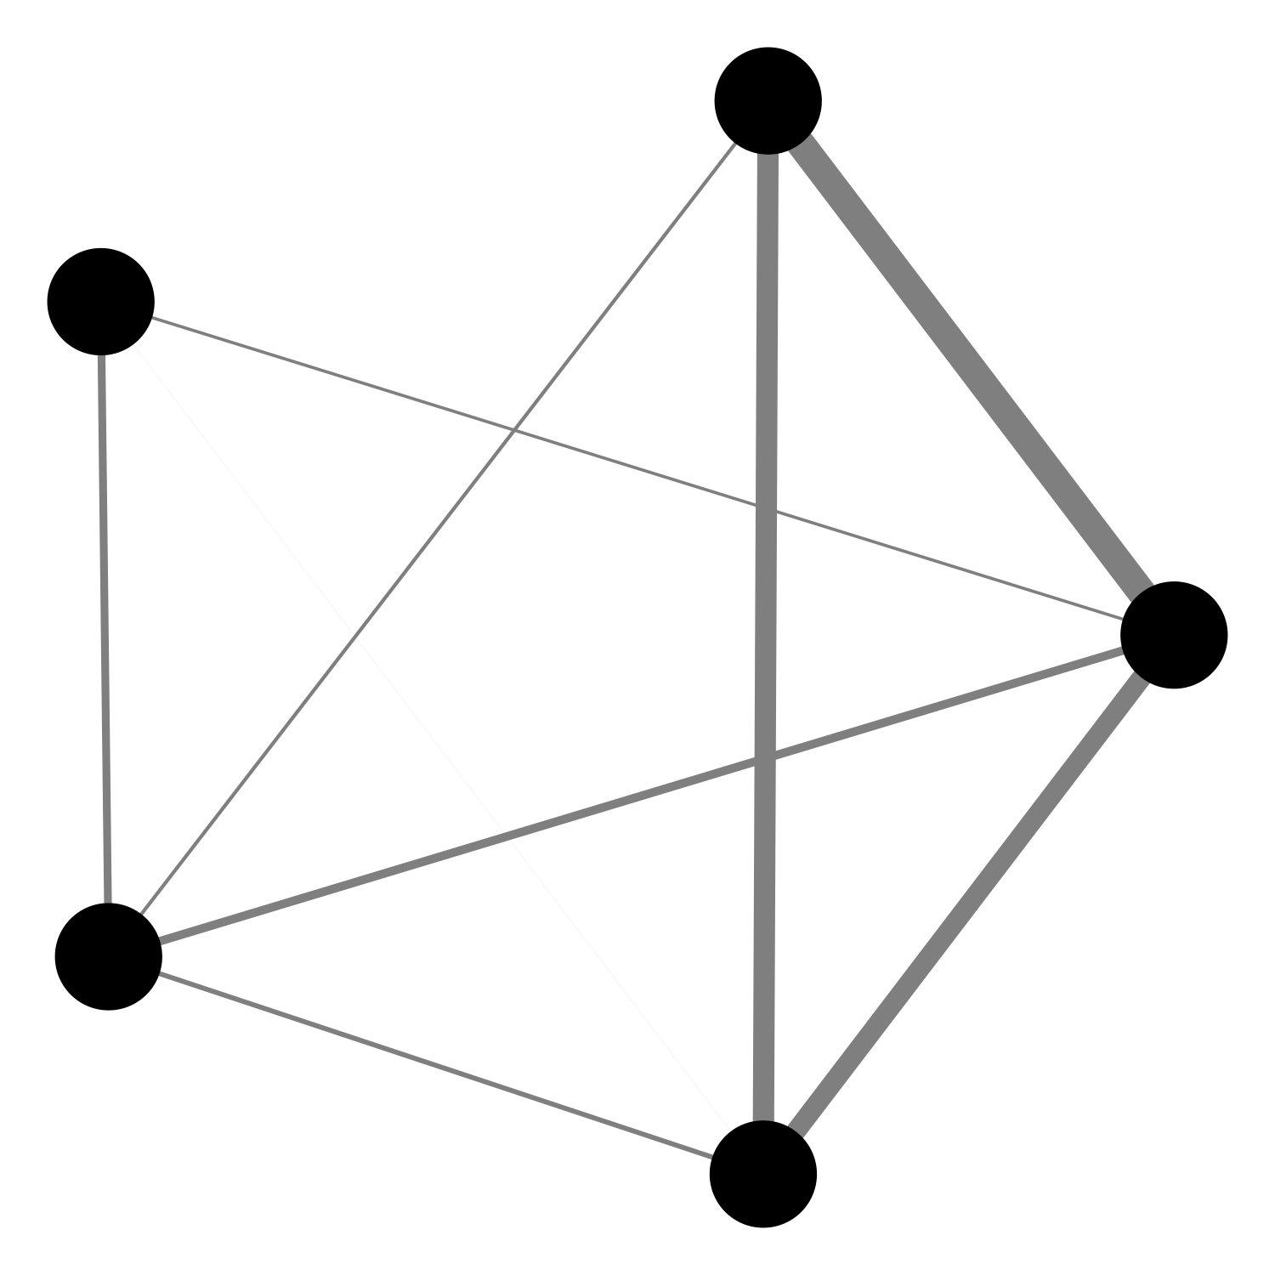
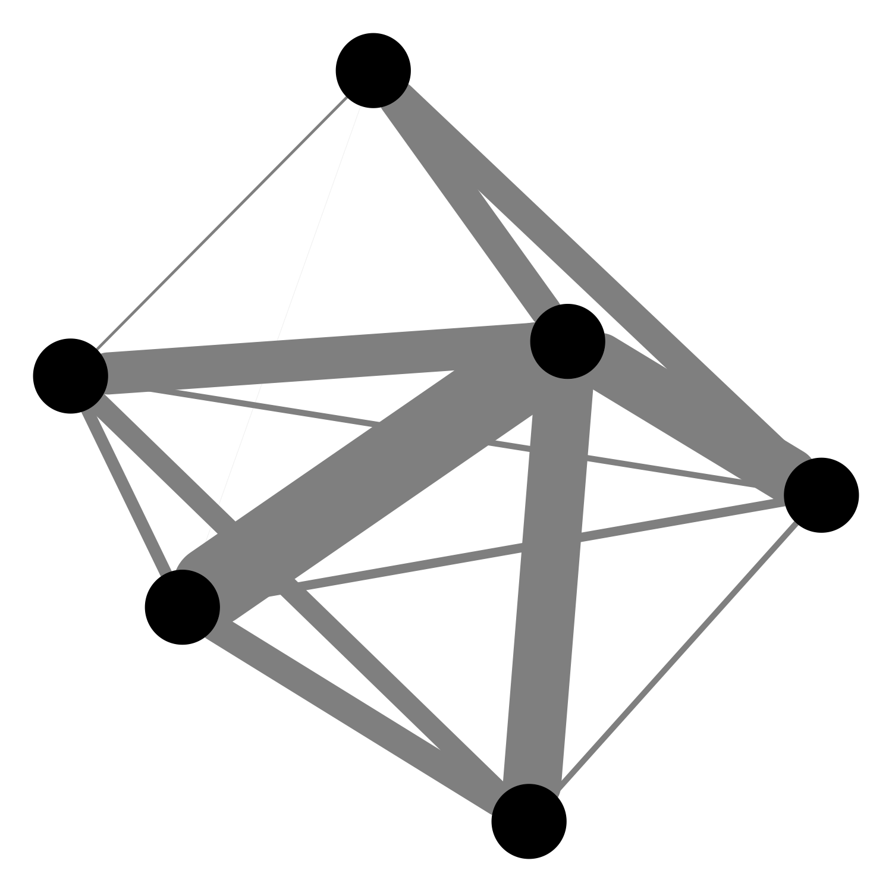
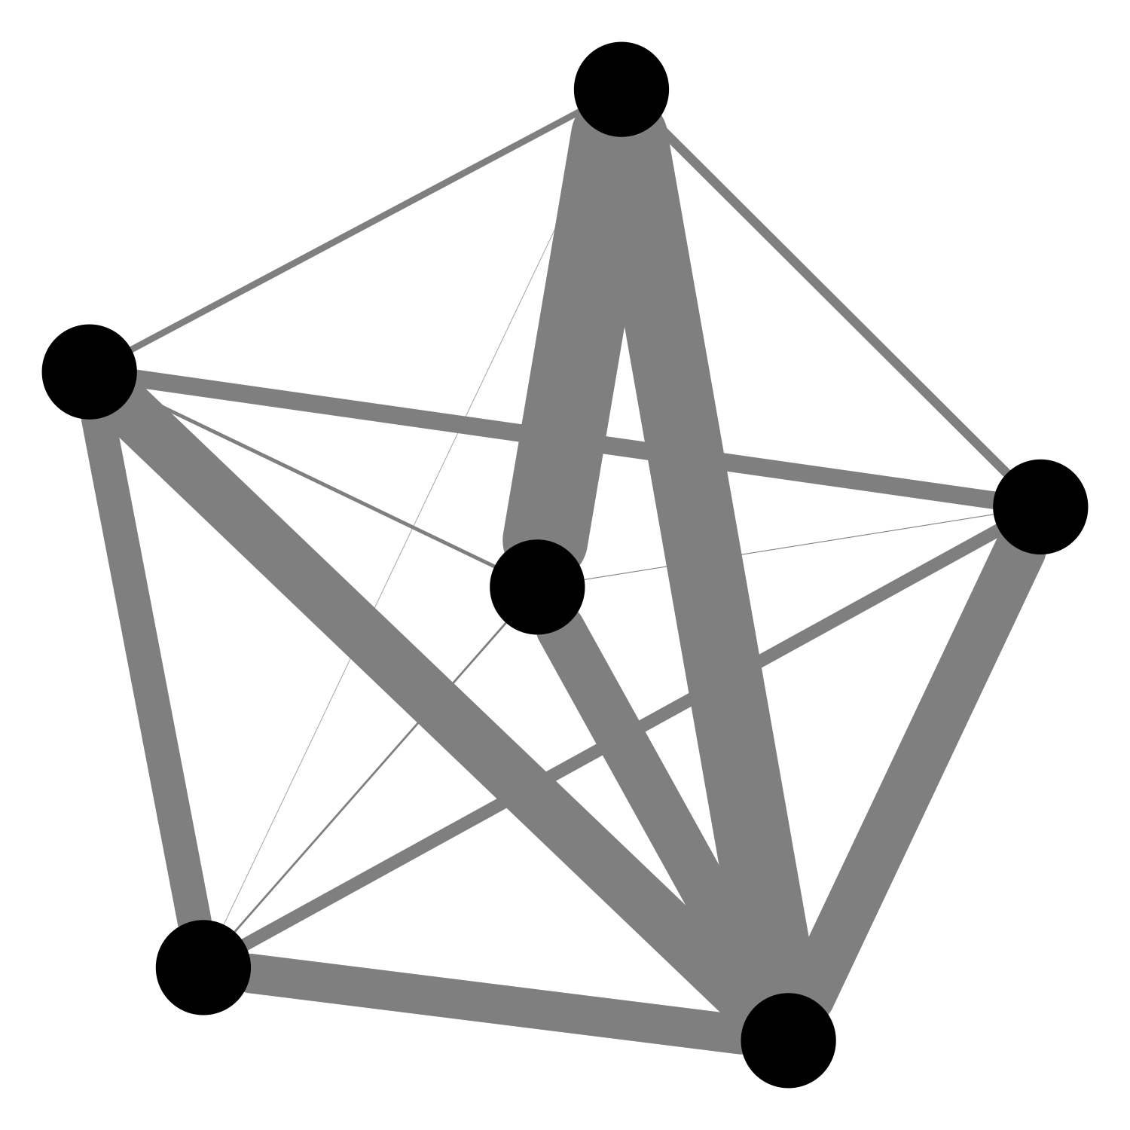
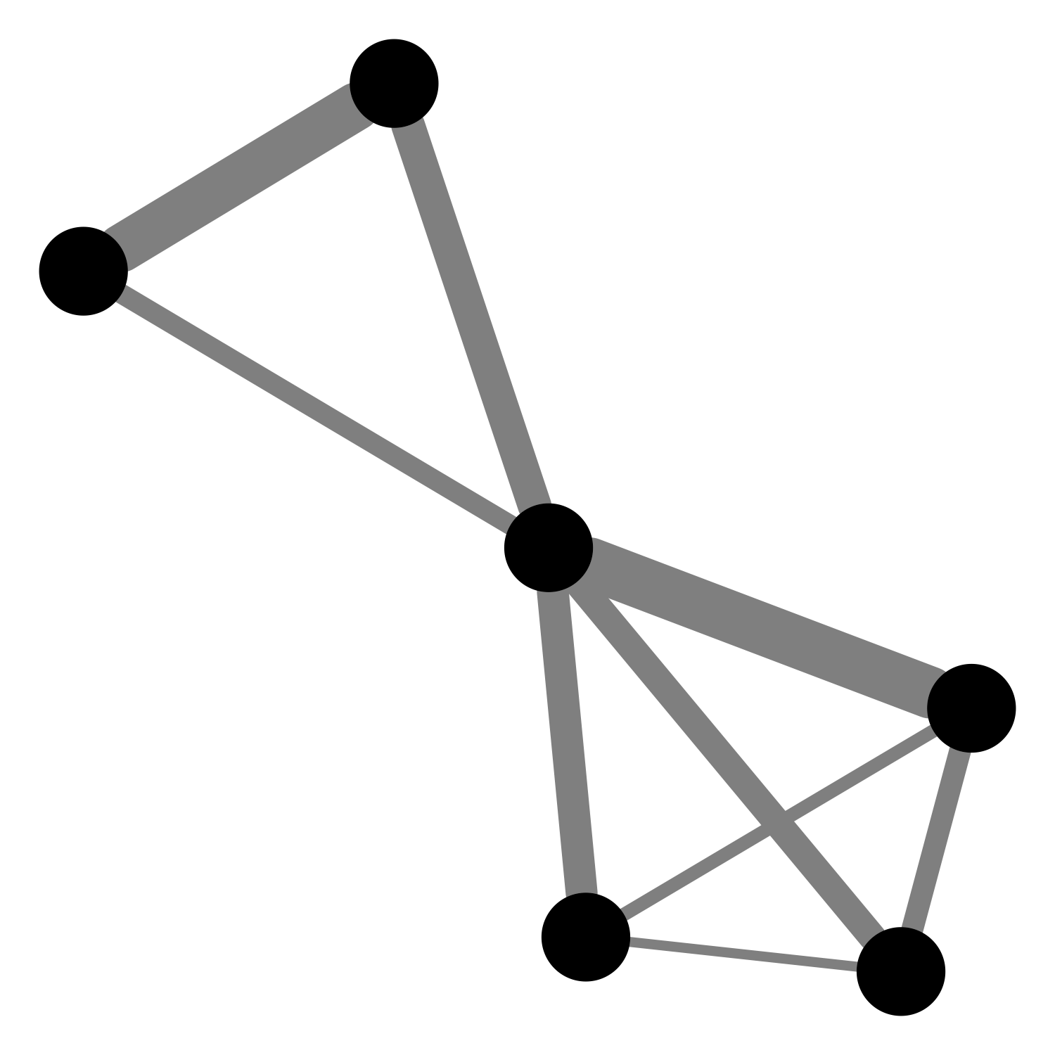
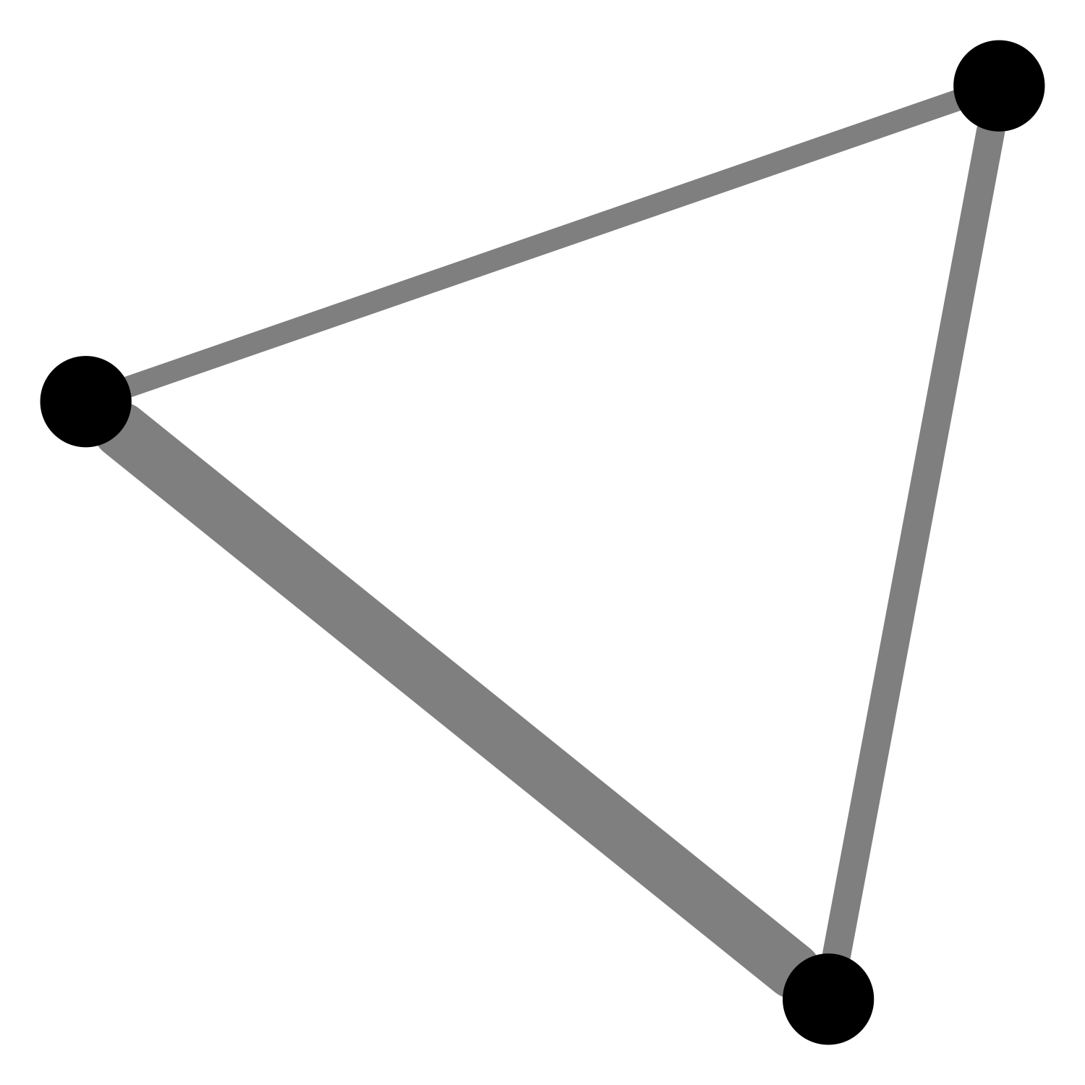
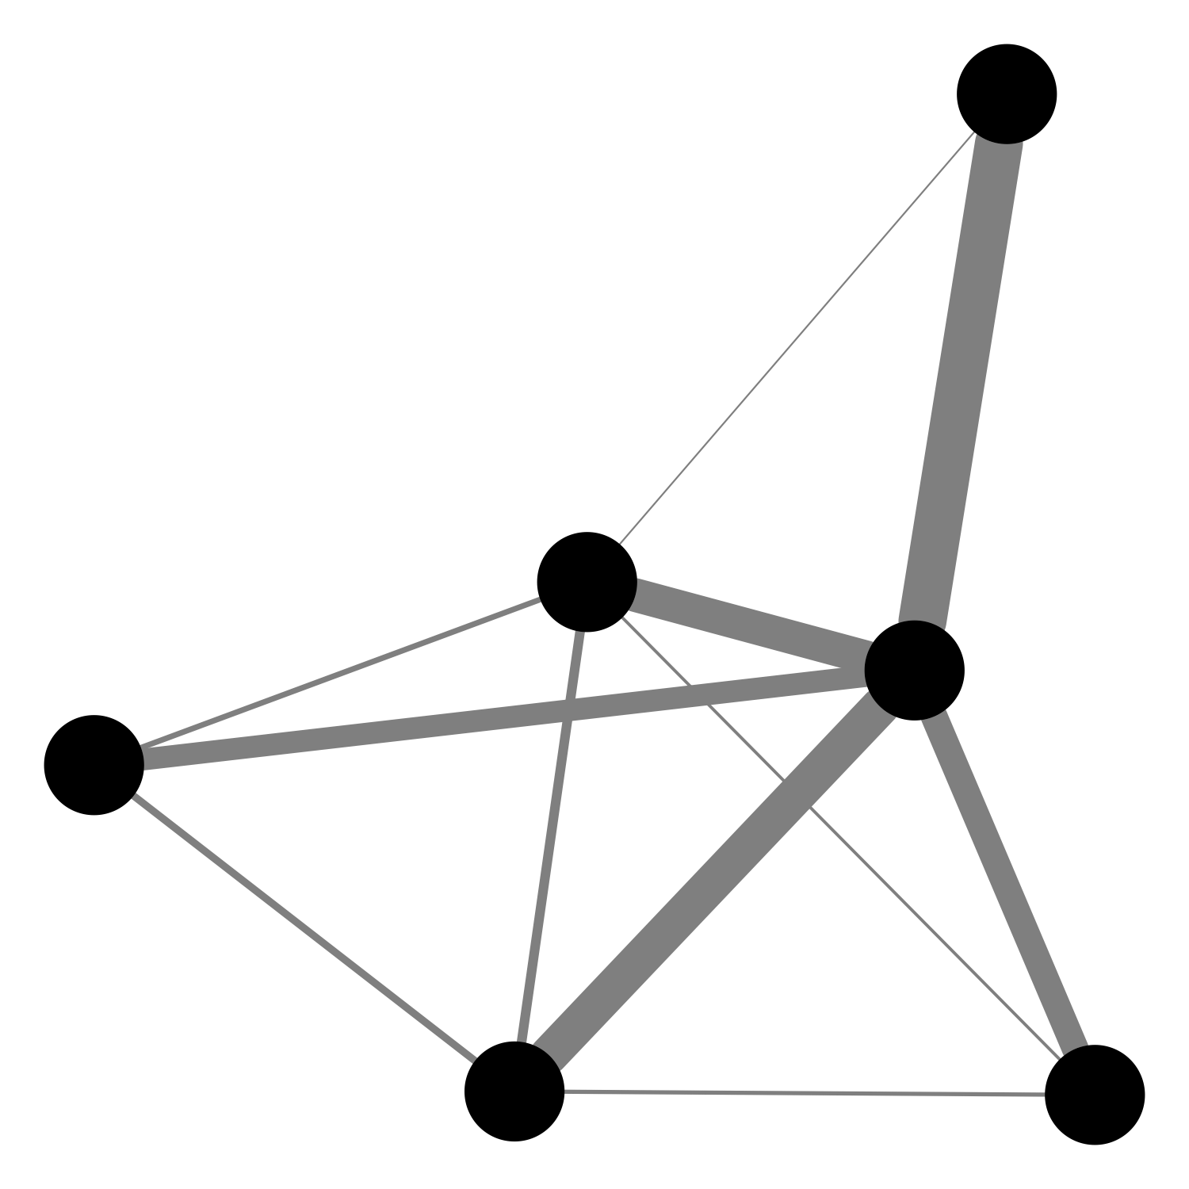
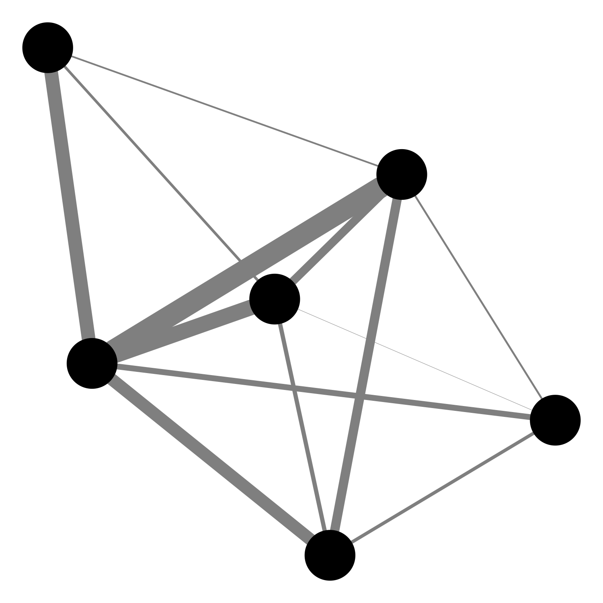
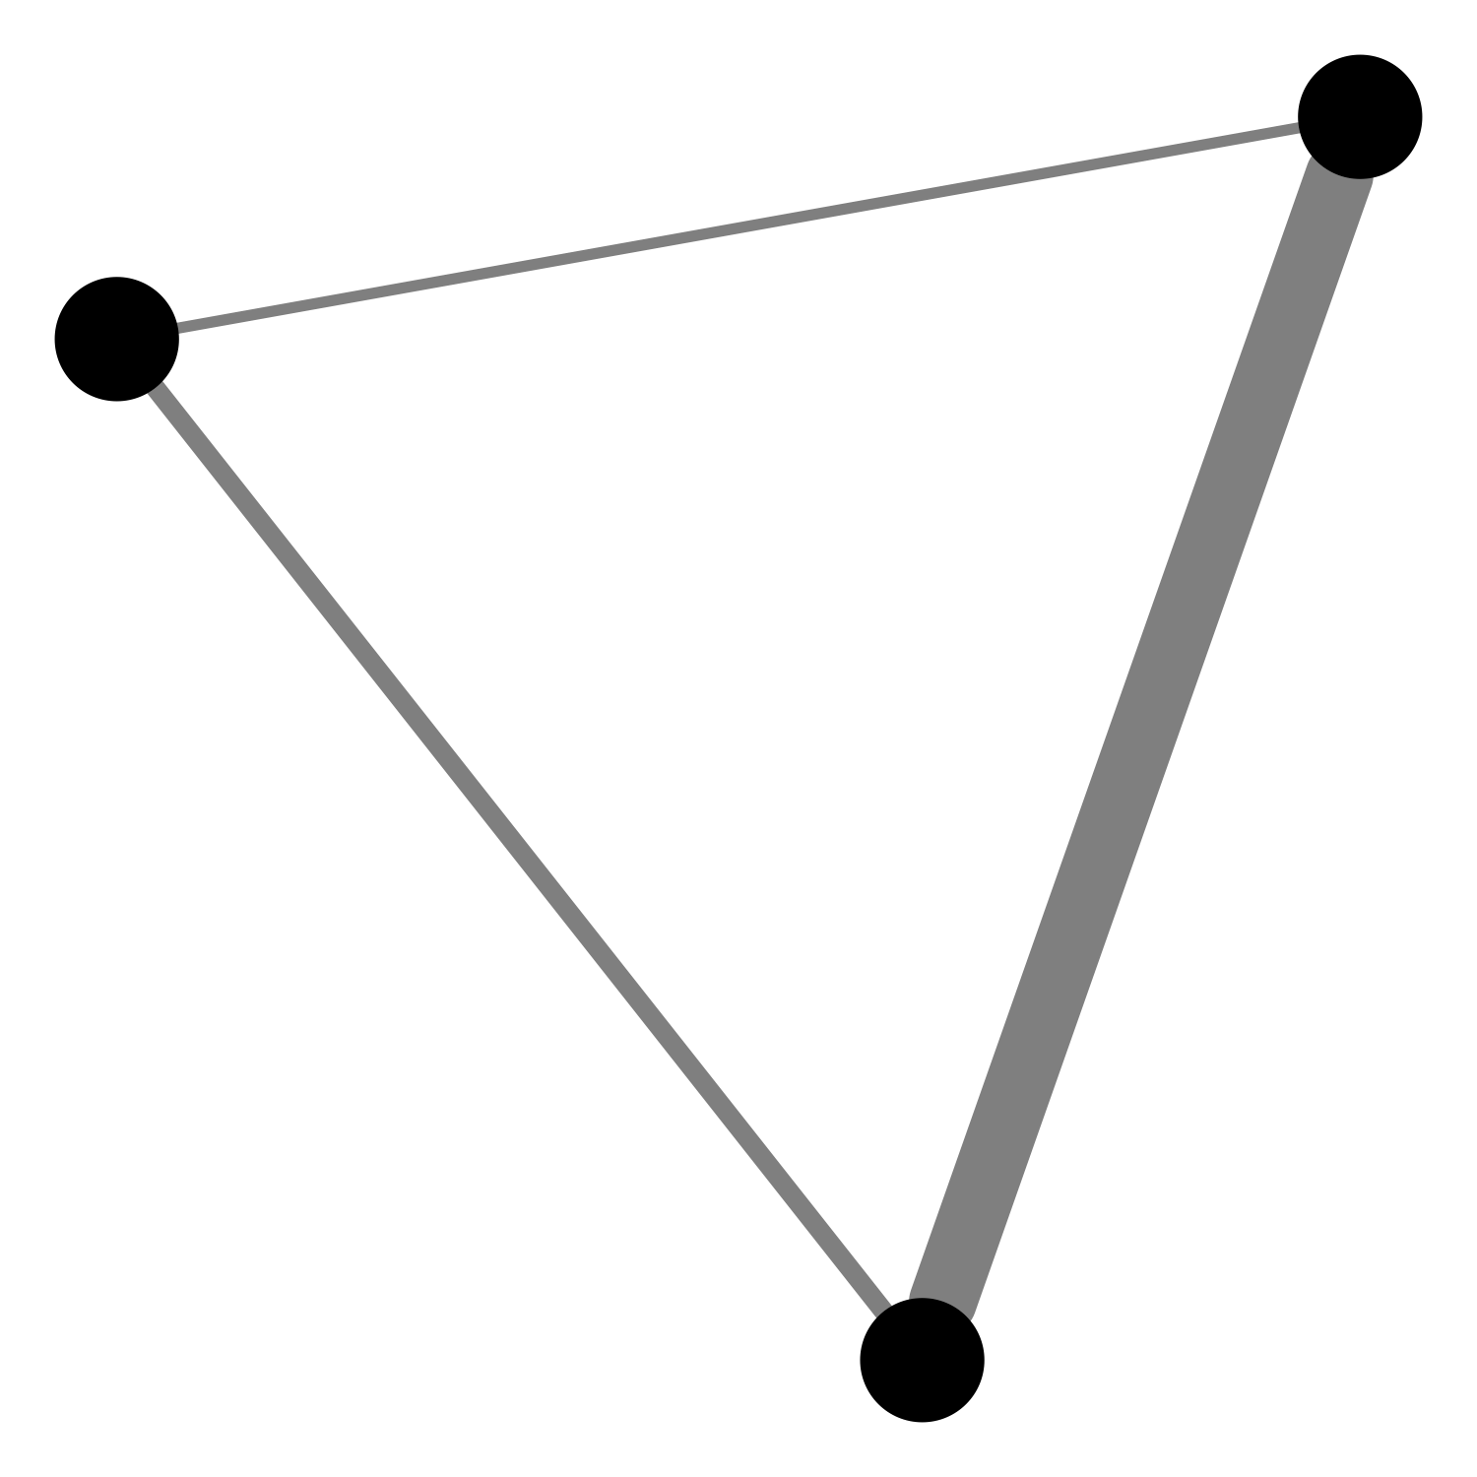
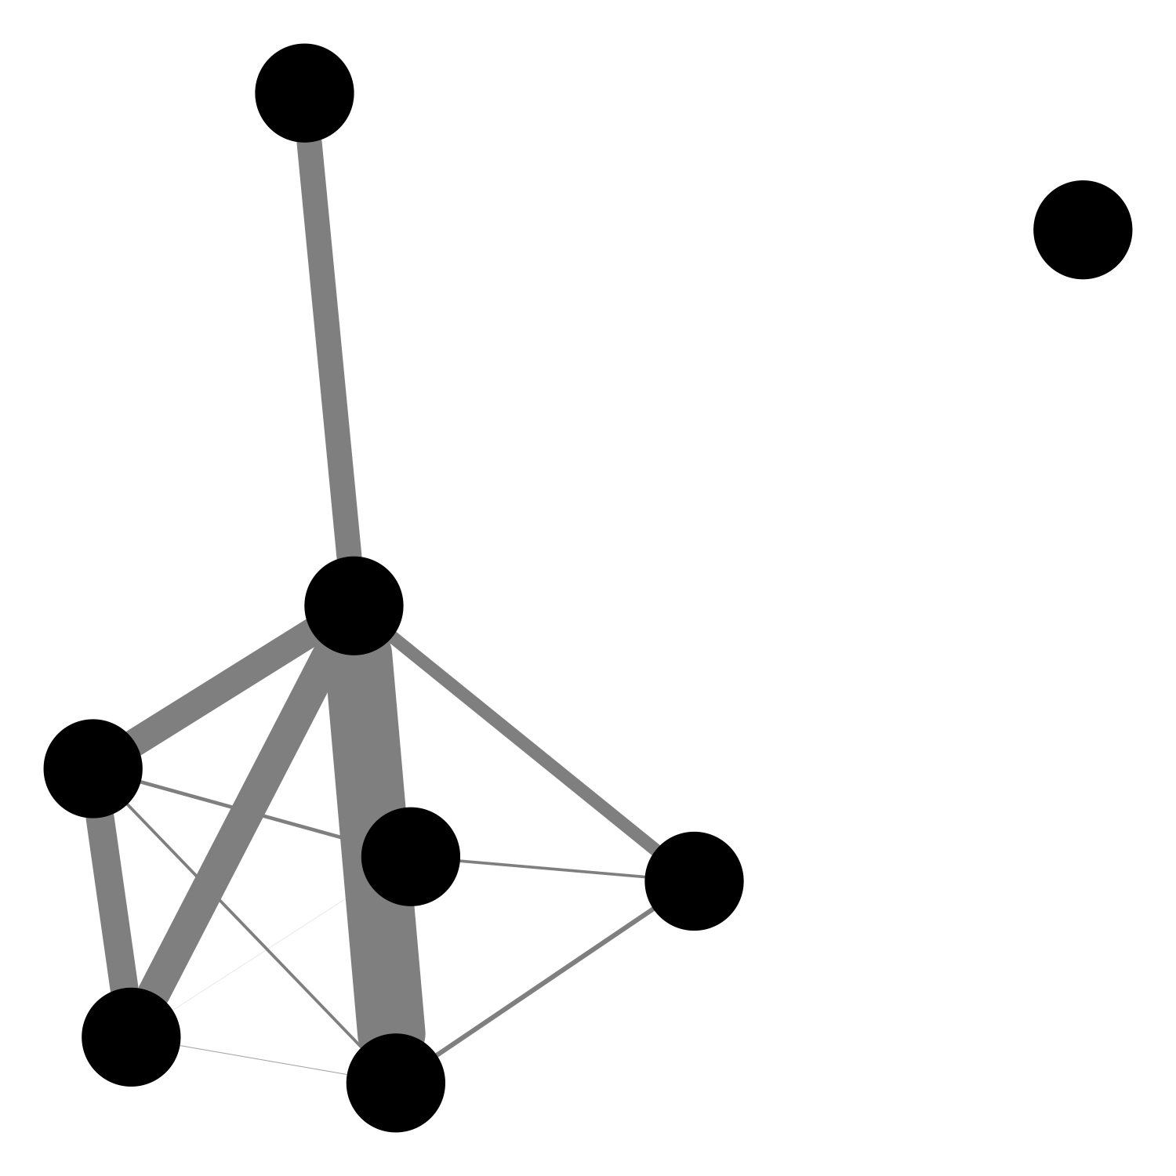
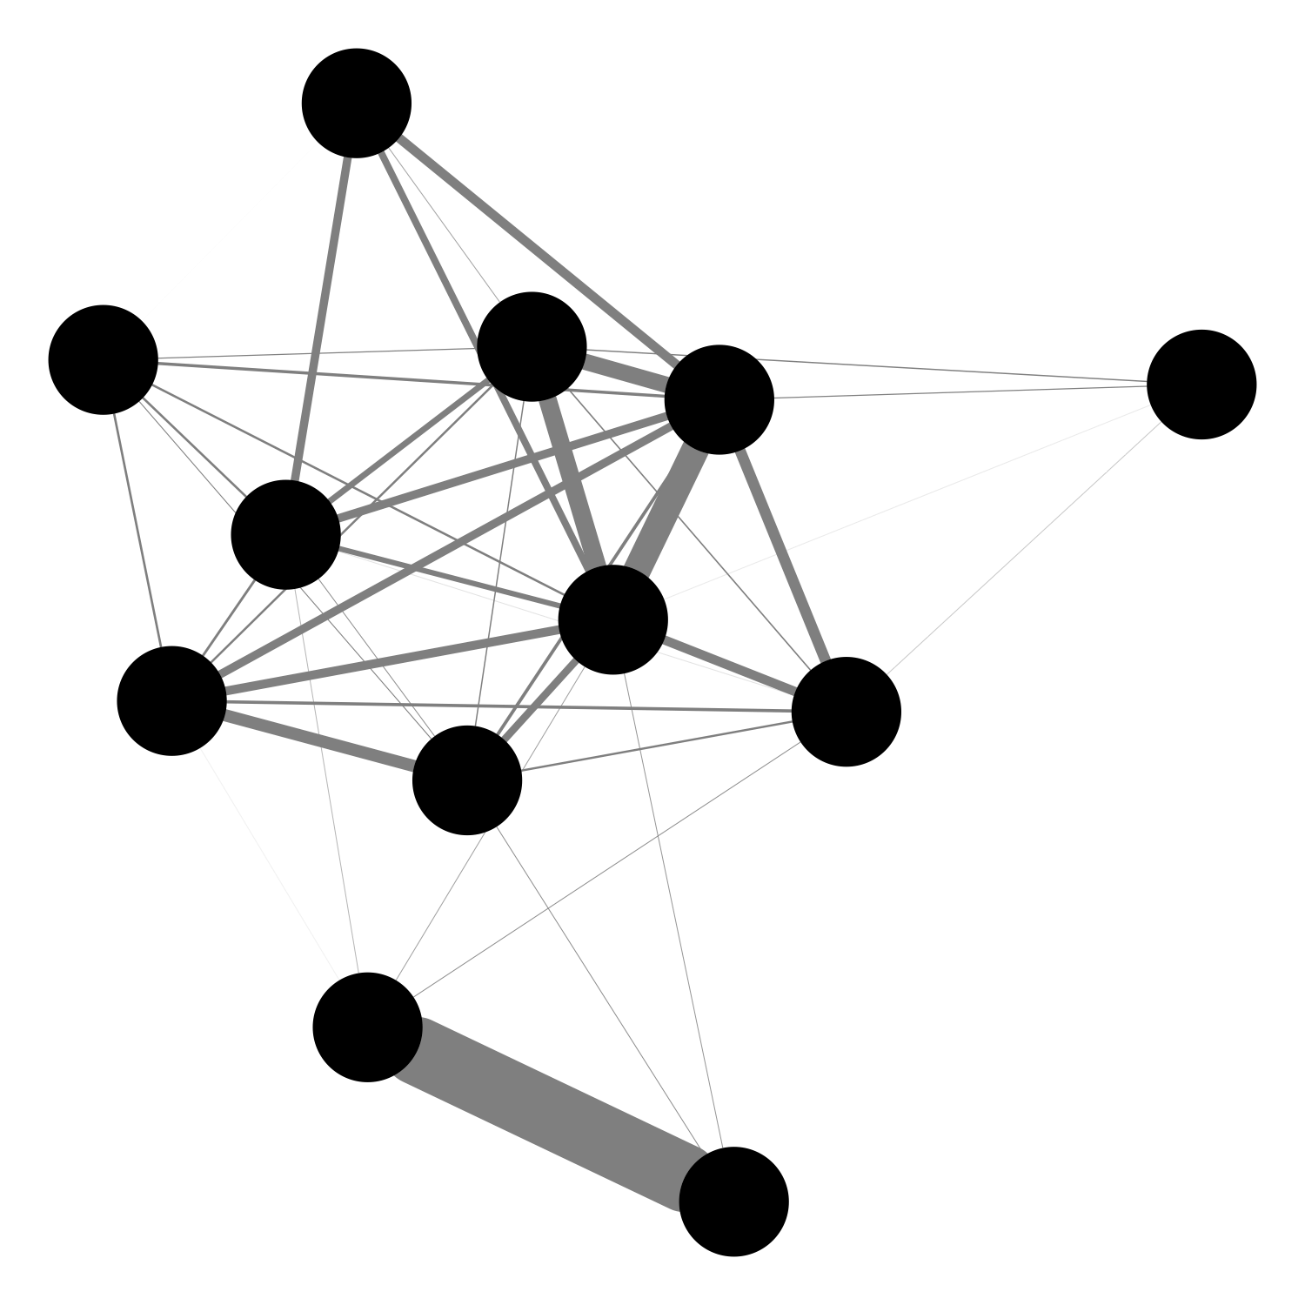
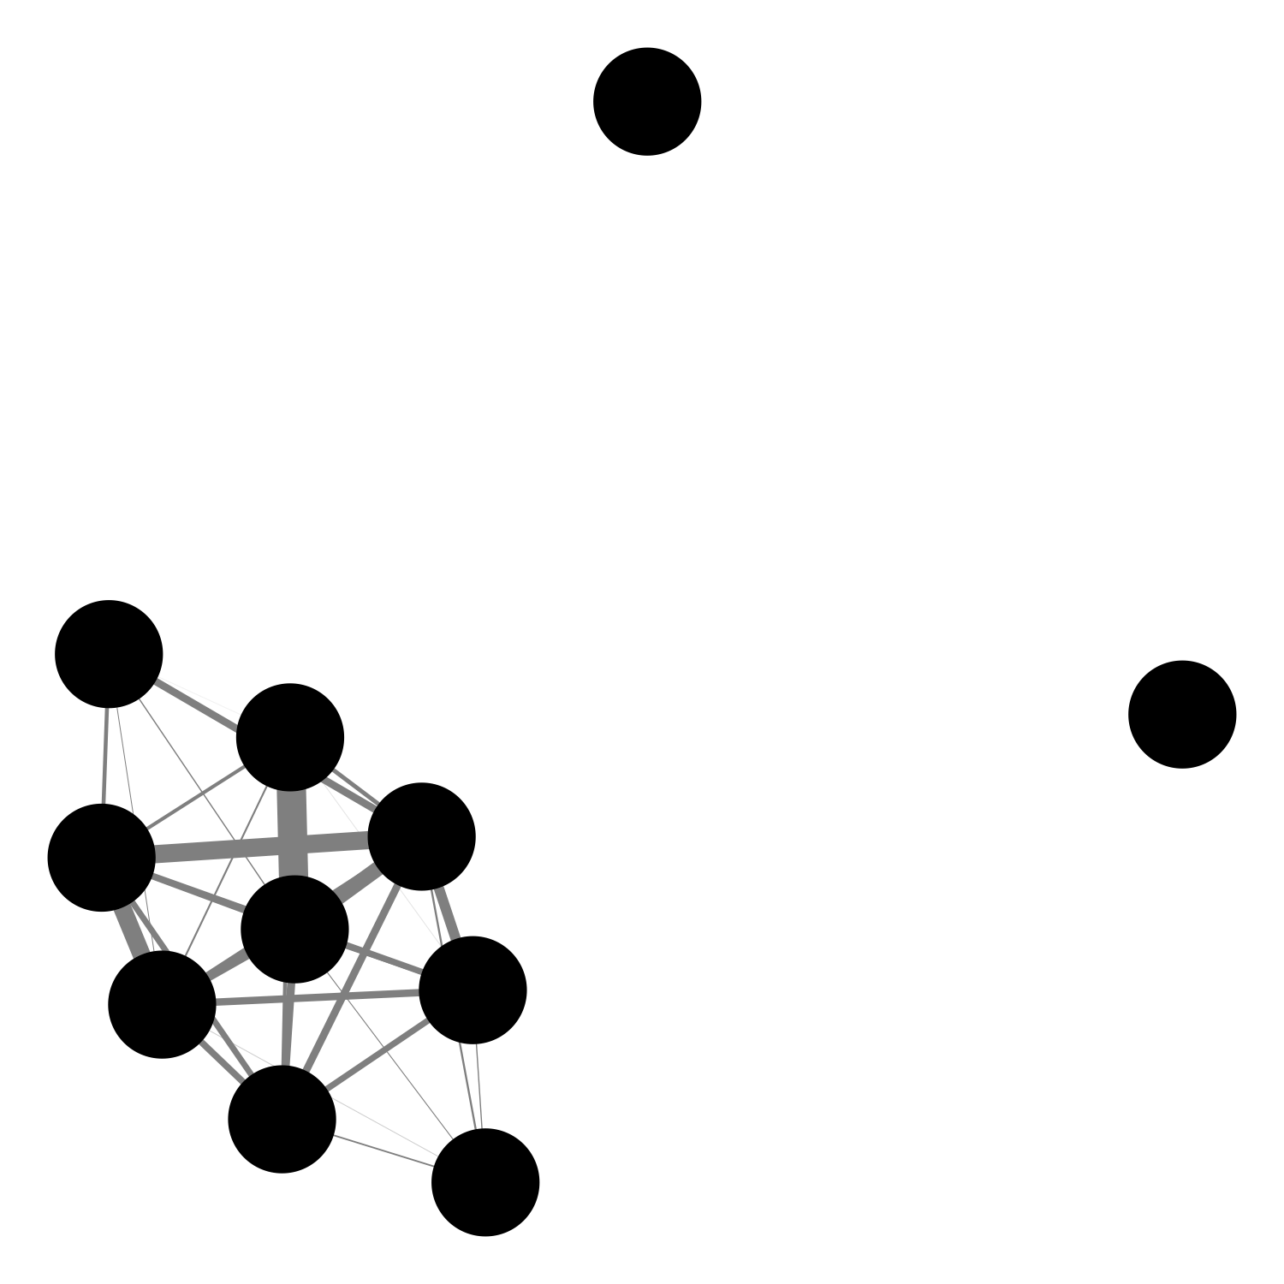
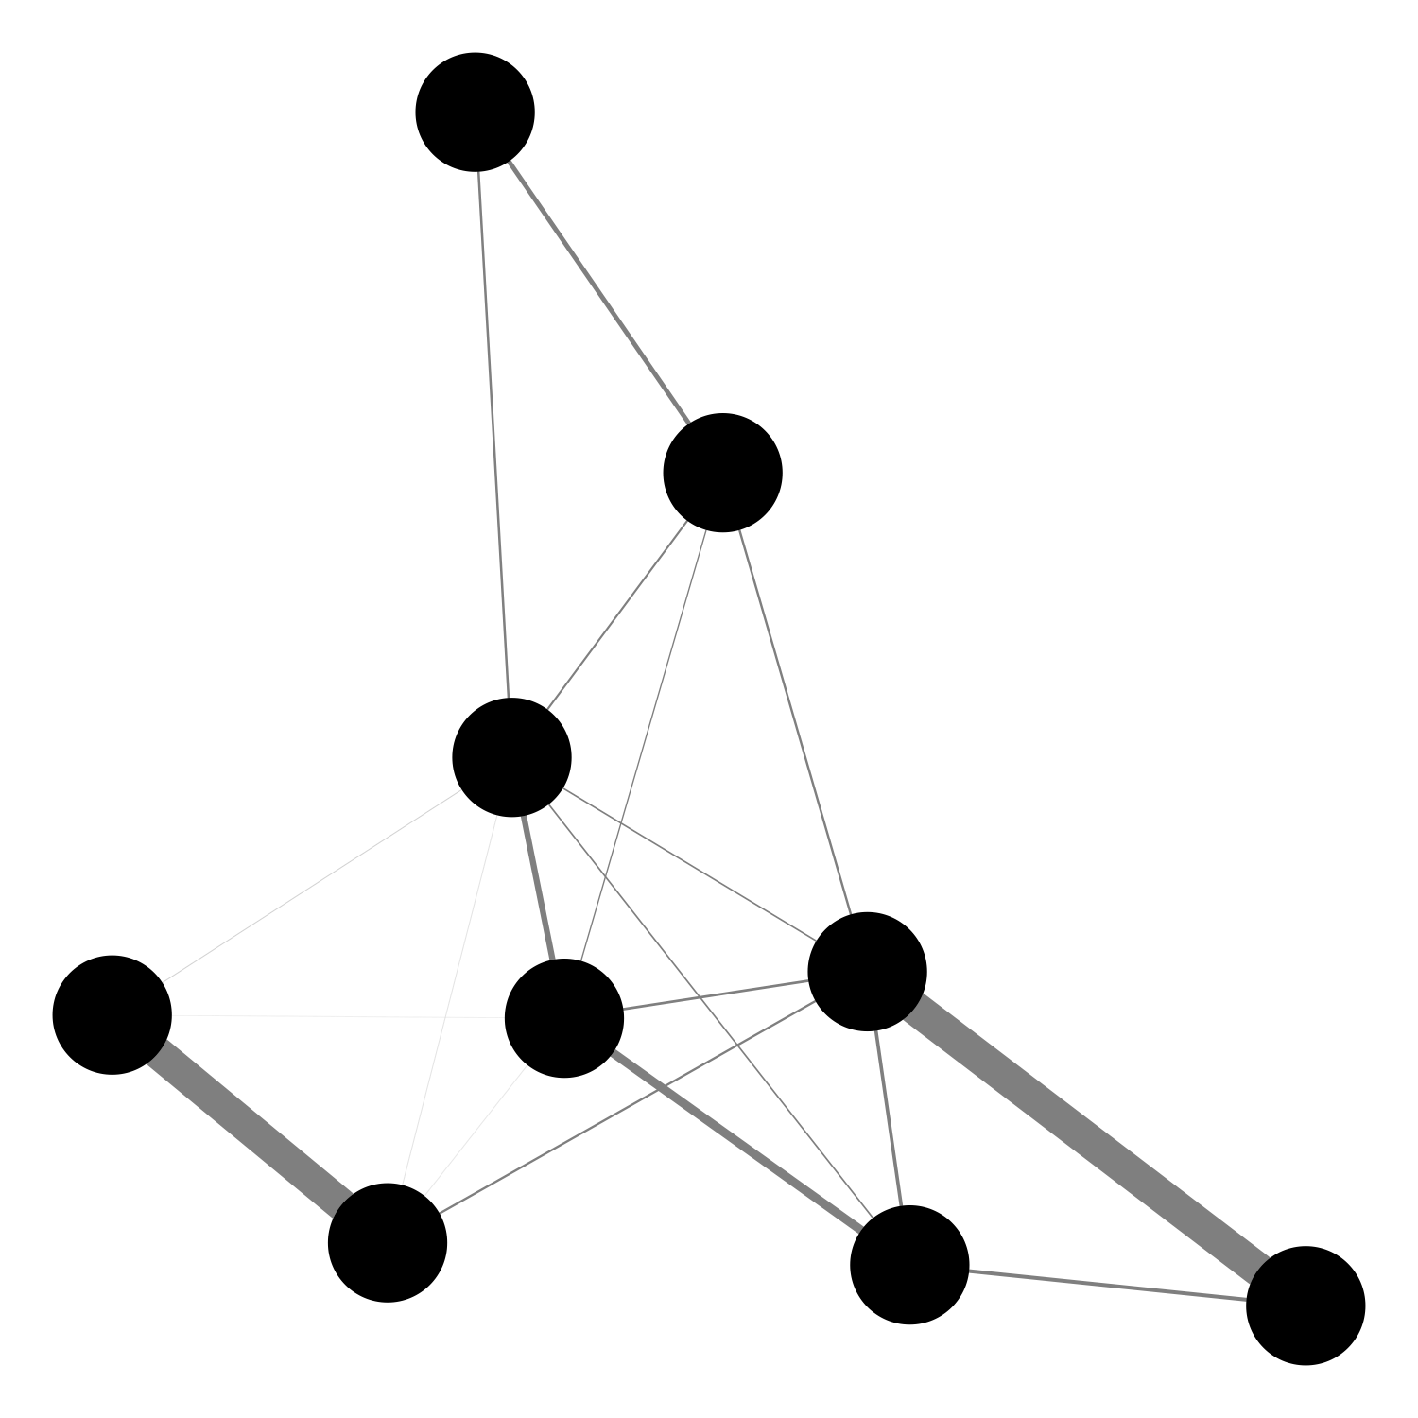
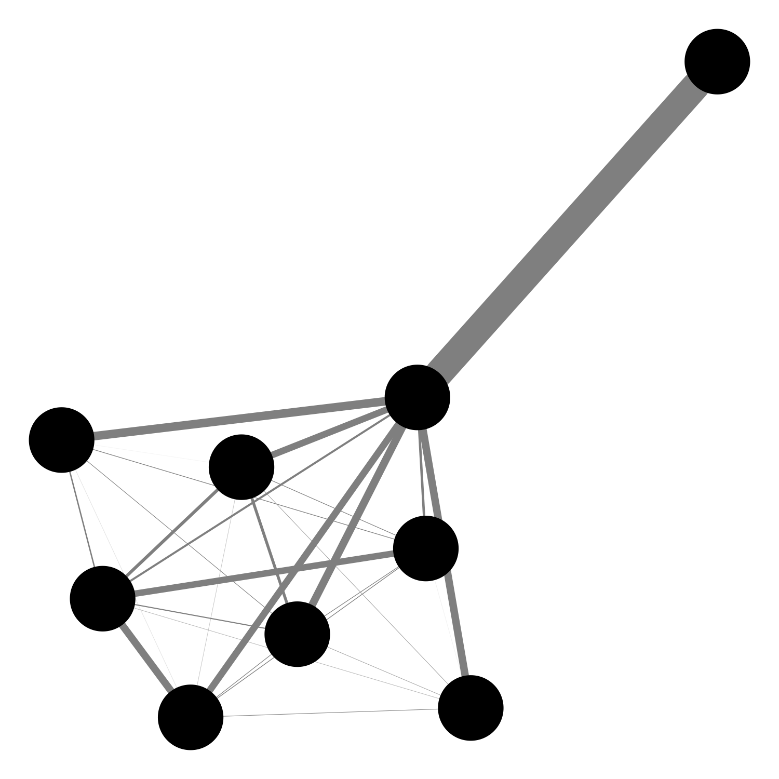
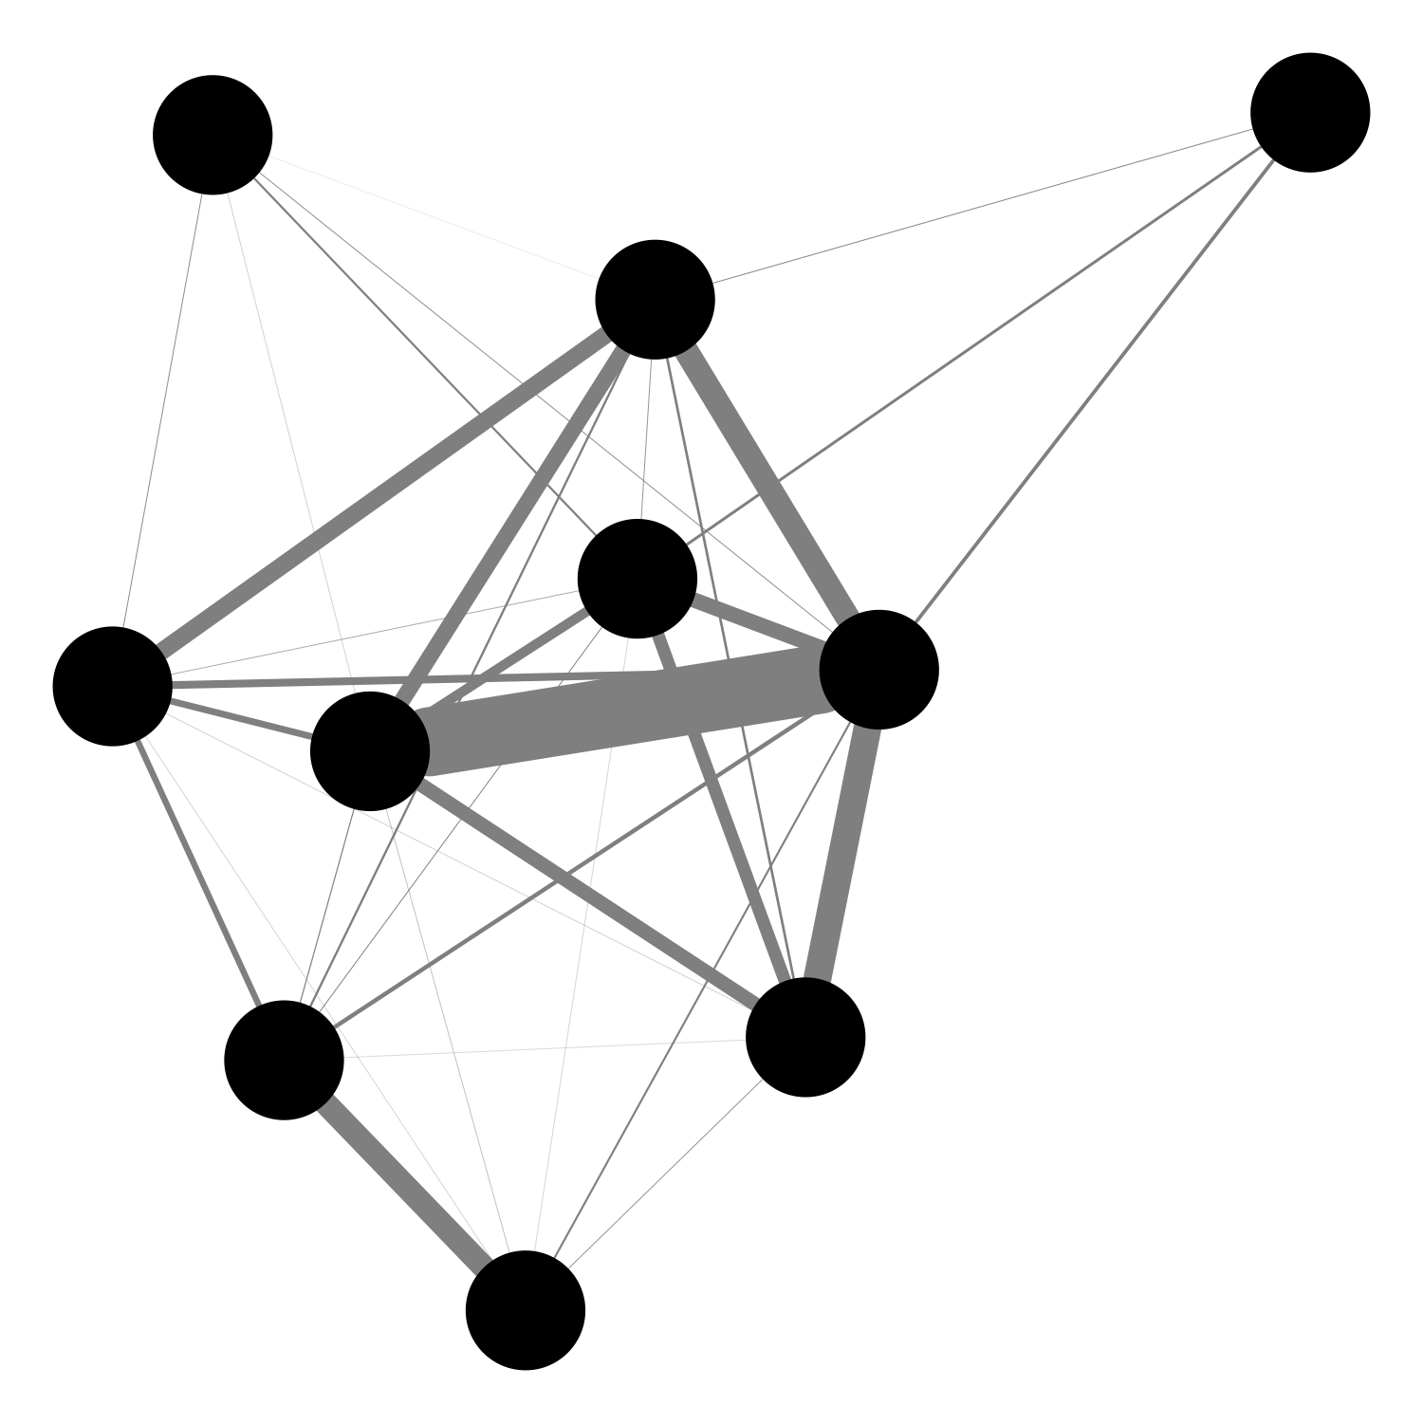
Dungeness Crab Pots
Spiny Lobster Pots
Market squid seine
Notes:
On the US west coast, Dungeness crab is king. But depending on latitude see spiny lobster occupy same central position. By revenue though, market squid follows up Dungeness crab. But some interesting differences. Dungeness crab is super central, and strongly connected to a host of diverse fisheries. Big boats, small boats, pelagics, benthics, inverts and fin fish. Market squid on the other hand are much more weakly connected.

Slide 6
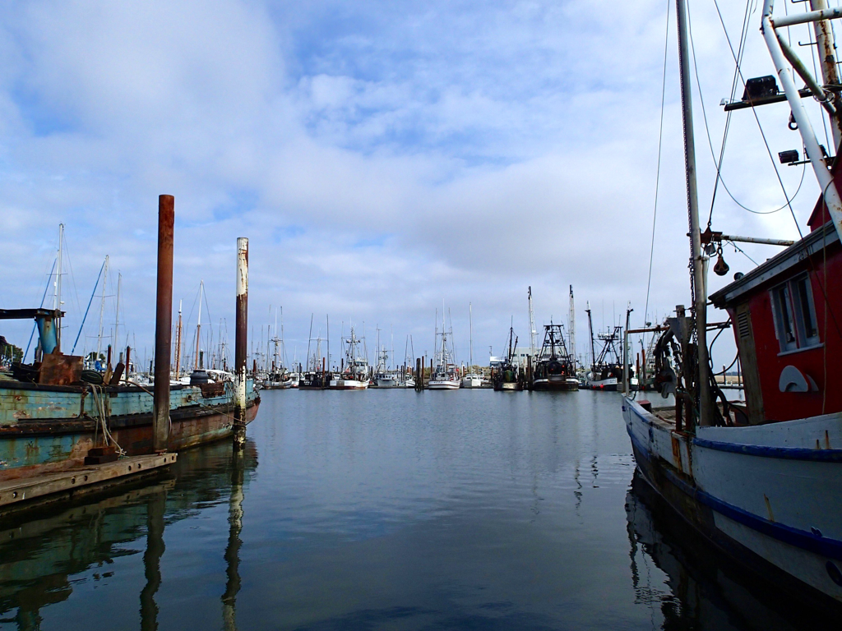
Did catch shares reduce risk for fishing vessels and communities?
Notes:
Example of a risk assessment, also timely for 5 year catch shares program review

Slide 7
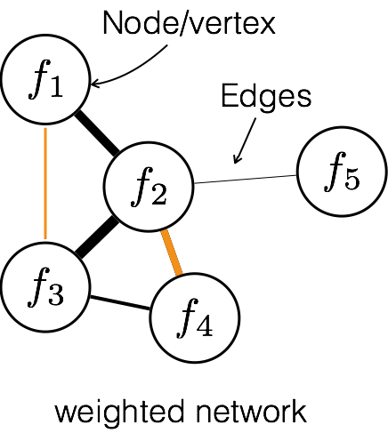
Consequences of catch shares part three: changes in participation network connectivity
Notes:
start with the basics: the points are called ‘nodes’ or ‘vertices’. Connections between them are ‘edges’. edges may have different ‘weights’ that in this case will represent how strongly the two nodes are connected to one another.
Edges = # vessels participating in both fisheries

Slide 8
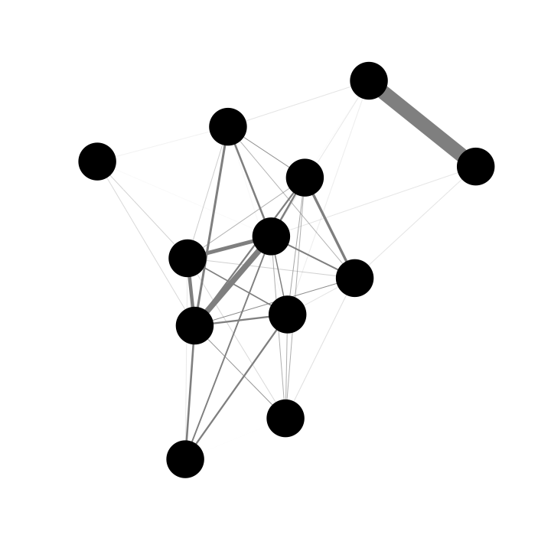
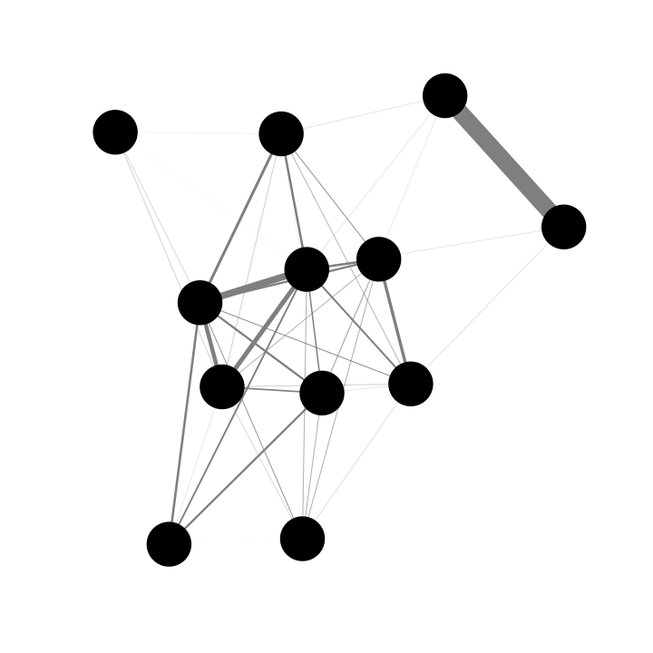
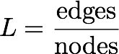
Measuring connectivity
Port - Level
catch shares
(2011)
time period
2009-2010
2012-2013
Link Density
connectivity
2.86
2.72
∆ connectivity
-0.14
Notes:
Compare landings by vessel before and after catch shares.

Slide 9
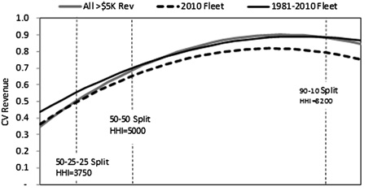
Reducing fishery and community vulnerability to climate change
Resource diversification reduces financial risk – adaptive capacity as scope for diversification?
Kasperski and Holland 2013 PNAS
Increasing diversification

Slide 10
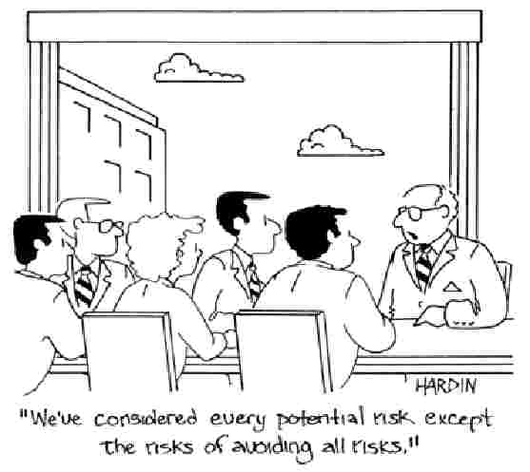
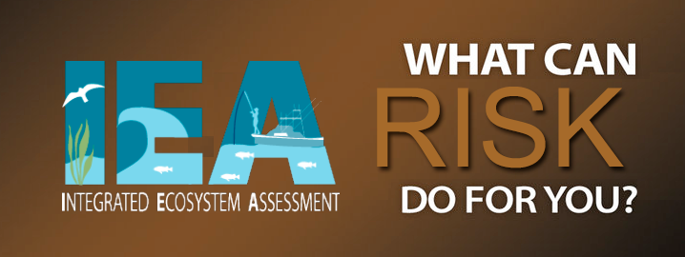
What kind of risk assessments- eco, socio-econ, integrated?
What time horizons?
What type of analysis?
Which issues?

Slide 11
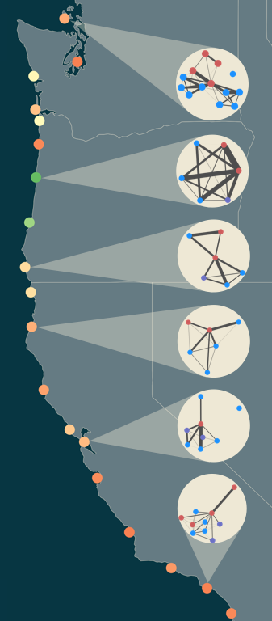
Governance across scales
Fisheries managed at both state and federal level
People commonly integrate across both in yearly strategies
Federal
State
Both
Fuller et al. (submitted)
Notes:
Another relevant observation here is that these fisheries are managed at different jurisdictional levels. Crab is state, groundfish is federal. Yet people commonly integrate both into a yearly strategy.
Here are some of the same networks but this time with nodes colored by jurisdiction.

